Slide 1
















Predict the winning team in the League of Legends World Championship 2023
INDENG242
Xilin Tian Xinyu Hou
Yunqi Liang Jiayi Fang

Slide 2
CONTENTS
https://www.ypppt.com/
01
LOL Introduction
02
Objective
03
Data Collection
04
Analytical Progress
05
Bootstrapping
06
Conclusion & Improvement

Slide 3
LOL Introduction
League of Legends (LoL): a multiplayer online battle arena video game developed and published by Riot Games.
In the game, two teams of five players battle together, During a match, a team wins by pushing through to the enemy base.
The 2023 Season World Championship (Worlds 2023) has 22 teams in total, which had to participate in three main stages.
In the final match of Worlds 2023, T1 3-0 edged out WBG to win the Championship! This is T1's fourth Champion, as well as the fourth for Faker!

Slide 4
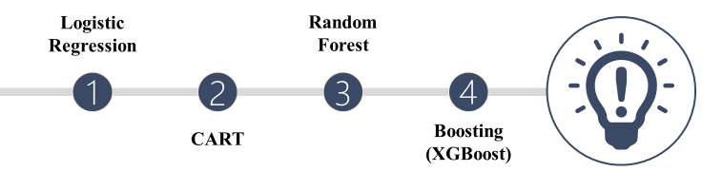
Objective
Our project aims to predict the winner of Worlds 2023 using logistic regression, CART, random forest, and XGBoost models. To refine our model, we employ K-mean, and use Bootstrapping to select the best model. Our prediction progress focuses on predicting the knockout stage, which is the game between the top eight teams.

Slide 5
Data Collection
We Collected
records for each team for the entire year from oracleselixir
wins and losses for each game of the Worlds from League_of_Legends_Esports_Wiki
From 2019 to 2023(5 yr)
368 matches, 19 attributes
A total of 16 teams compete at Swiss stage. In order to join the datasets of two opposing teams together, we subtract the data of the red team from the blue team for each game to get the difference between the two teams as the INDEPENDENT variable of the dataset; and whether the blue team wins or not as the DEPENDENT variable of the dataset. Thus, we obtain a new dataset that will be based on the predicted the winning rate of the blue team for further analysis.

Slide 6
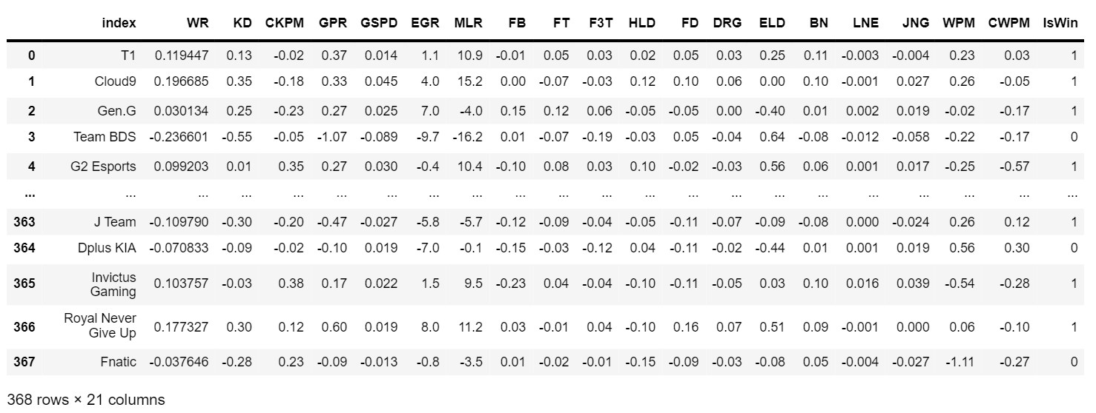

Slide 7
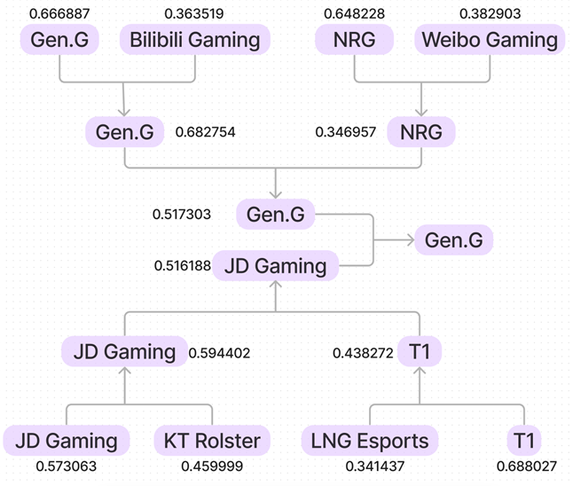
Logistic Regression
Excluded variables with high VIF and high p-values
Accuracy:0.65
Champion: Gen.G

Slide 8
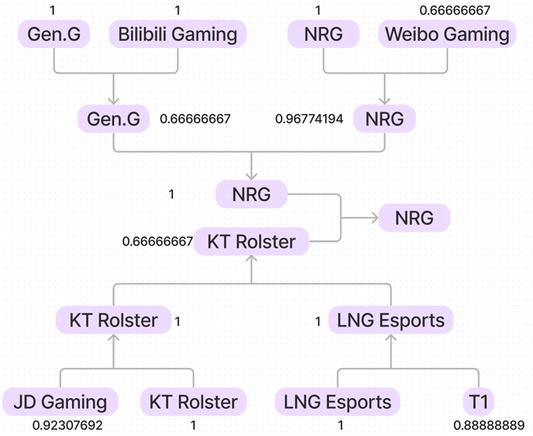
CART
Selected feature by importance
Used GridSearchCV for best ccp_alpha
Applied KFold
Accuracy: 0.58
Champion: NRG

Slide 9
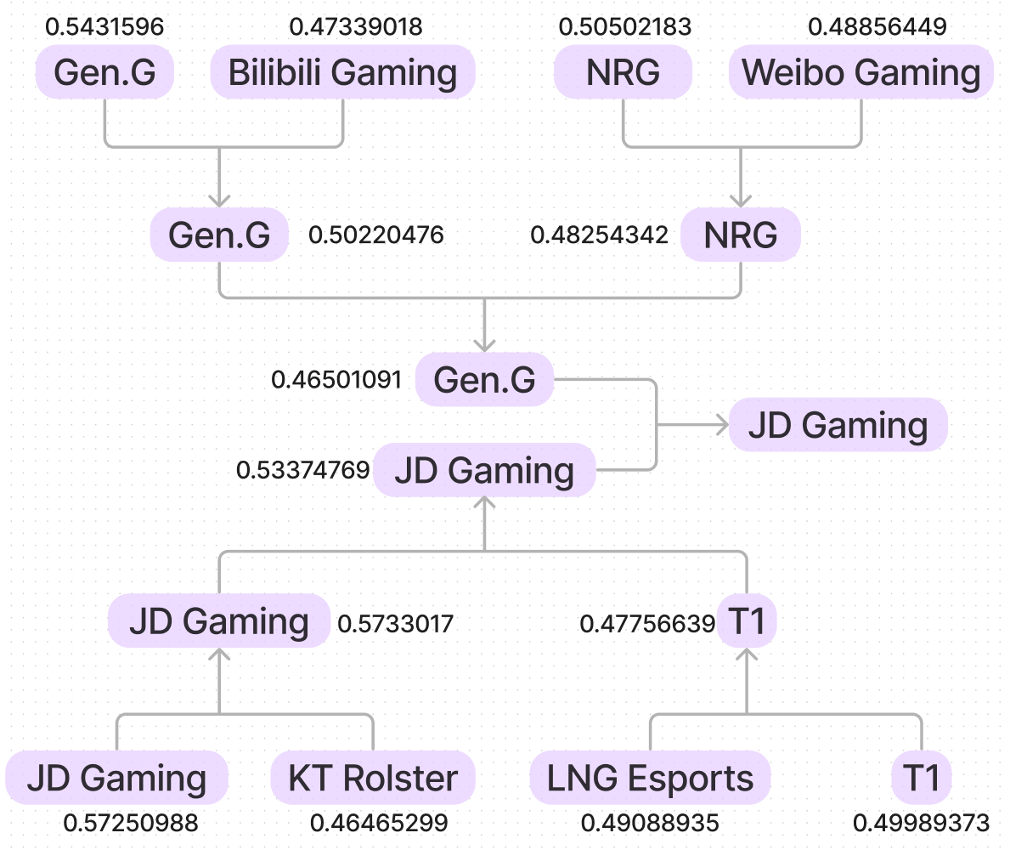
Random Forest
Excluded variables with high correlation coefficient and low feature importance
Applied KFold
Used GridSearchCV for best parameters
Average Accuracy:0.62
Champion: JD Gaming

Slide 10
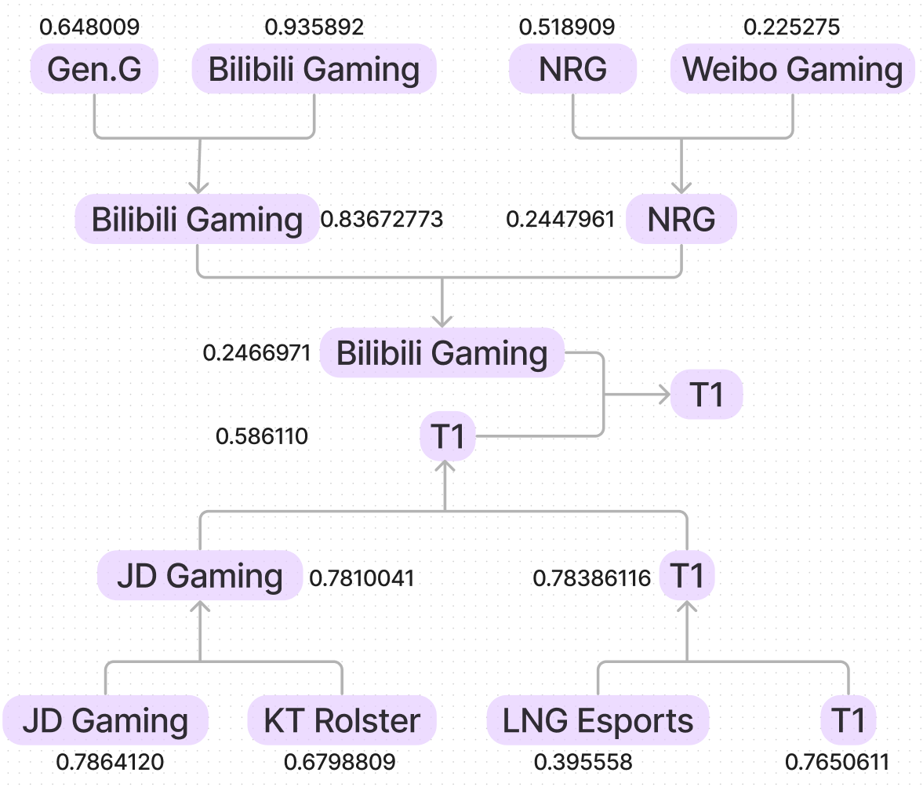
Boosting
XGBoost
Selected feature by importance
Initial Accuracy: 0.57;
AUC: 0.56
After Selection Accuracy: 0.54;
AUC: 0.57
Champion: T1

Slide 11
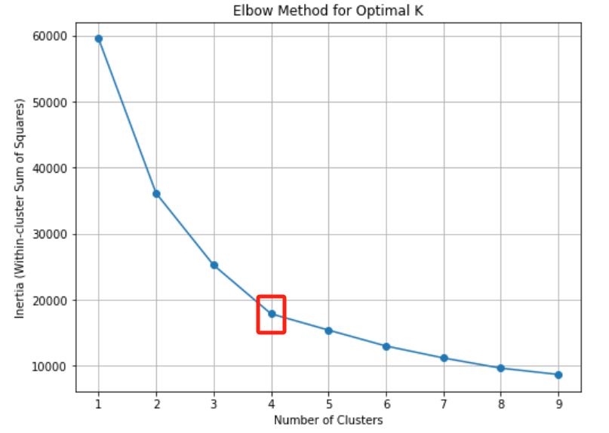
K-mean
Used K-mean to clustering our matches and added the resulting label as a new attribute.
Then implemented to our 4 models
Based on the elbow point, the cluster should be 4.

Slide 12
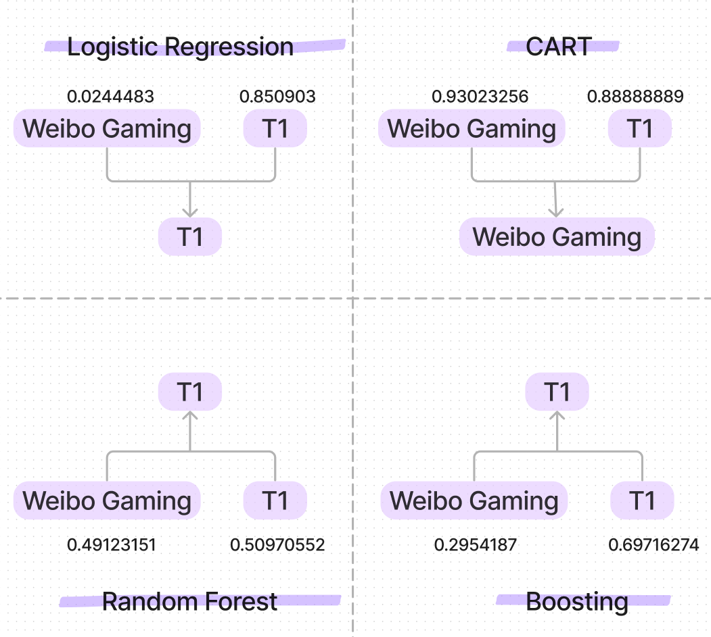
K-mean

Slide 13

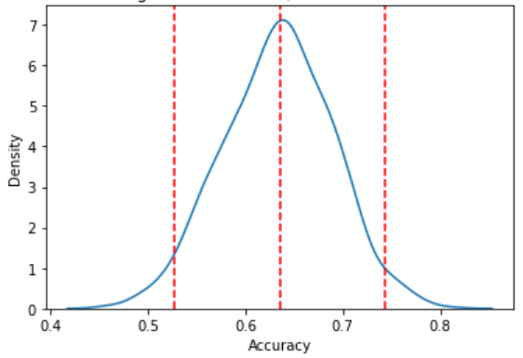
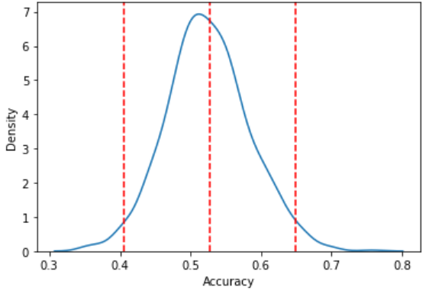
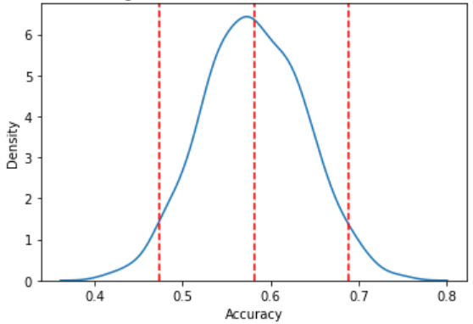
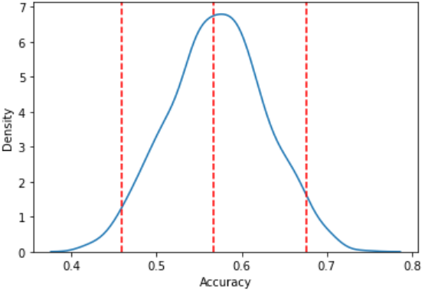
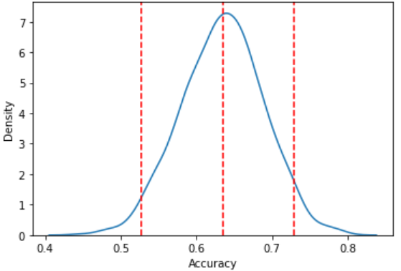
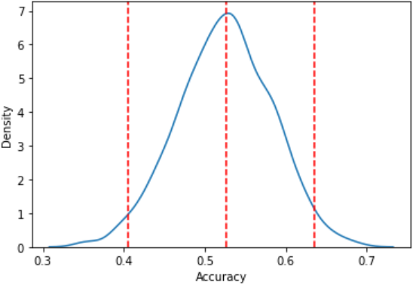
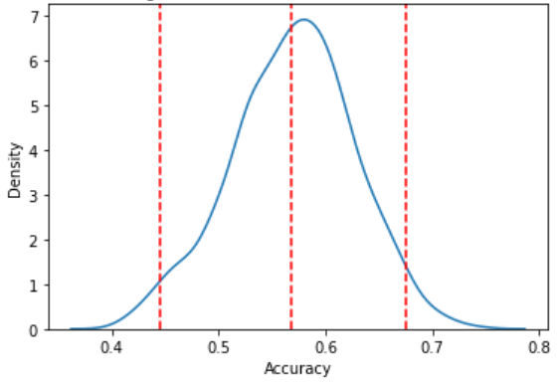
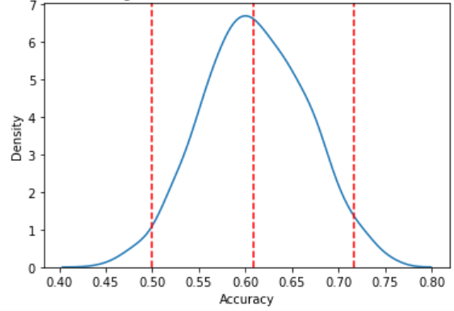
Bootstrapping
Logistic Regression CART Random Forest Boosting
mean: 0.64 mean: 0.53 mean: 0.58 mean: 0.57
CI: [0.53,0.74] CI: [0.41,0.65] CI: [0.47,0.69] CI: [0.46,0.68]
With K-mean feature: Logistic Regression CART Random Forest Boosting
mean: 0.64 mean: 0.53 mean: 0.57 mean: 0.61
CI: [0.53,0.73] CI: [0.41,0.64] CI: [0.46,0.60] CI: [0.5,0.72]

Slide 14
Conclusion & Improvement
Boosting plays best and it is stable
Adding k-mean clusters as a feature does not improve the model very much
Guessing of further improving the accuracy:
The effect of losing or winning matches in different formats such as best-of-three or best-of-five on a team's performance in the next match.
Some teams have good yearly average stats but don't do well in Worlds because of the level gap between regions, so the difference between regions can be used as a variable for the future.

Slide 15
Thank you for your listening!
INDENG242

